Slide 1


SMART HOME ENERGY
MANAGEMENT
by Bharathi Selvaraj

Slide 2
modules
what is SHEMS?
Module 1: Authentication and Role Management
- Main Classes:
1. UserAuthController
2. AuthService
3. UserRepository
Smart Device Management
- Main Classes:
1. Device
2. DeviceController
3. DeviceService
4. DeviceRepository
The Smart Home Energy Management System (SHEMS) is a Java-powered web platform that helps monitor, analyze, and manage energy usage within a household.
It continuously observes the electricity consumption of various devices, estimates upcoming usage patterns, and offers guidance to lower overall power costs.
SHEMS includes an interactive dashboard that displays live energy data, highlights peak consumption periods, provides cost projections, and delivers practical tips for improving energy efficiency.
Real Time Energy Tracking
- Main Classes:
1. UsageLog
2. EnergyTrackingController
3. EnergyTrackingService
4. UsageRepository
Analytics Dashboard
- Main Classes:
1. AnalyticsController
2. AnalyticsService
3. ChartGenerator
4. AnalyticsRepository
Scheduling and Automation
- Main Classes:
1. Schedule
2. SchedulerController
3. SchedulerService
4. NotificationService
5. SchedulerRepository
Recommendation System
- Main Classes:
1. Recommendation
2. RecommendationController
3. RecommendationService
2

Slide 3
A quick review
MODULE 1: Authentication & Role Management
MODULE 2: Smart Device Management
Handles secure user login and registration through UserAuthController
Validates user credentials using AuthService
Enforces role-based access control before system usage
Stores and retrieves user details via UserRepository
Separates responsibilities using Controller–Service–Repository layers
Ensures only authorized users can access system features
Manages all smart home devices using the Device model
Accepts device control requests through DeviceController
Applies business logic in DeviceService
Updates and stores device data using DeviceRepository
Maintains real-time device status (ON / OFF)
Integrates with Module 1 for secure device access
3

Slide 4
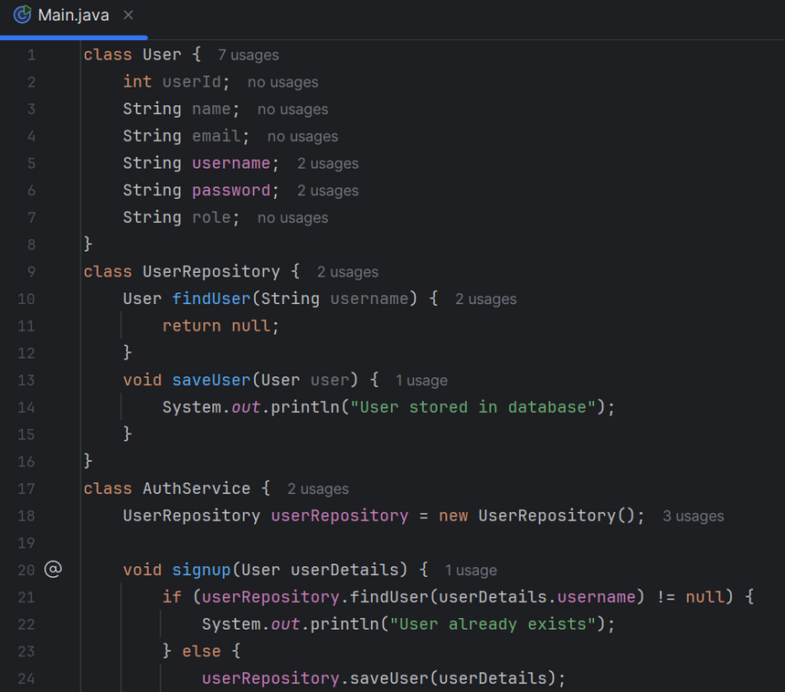
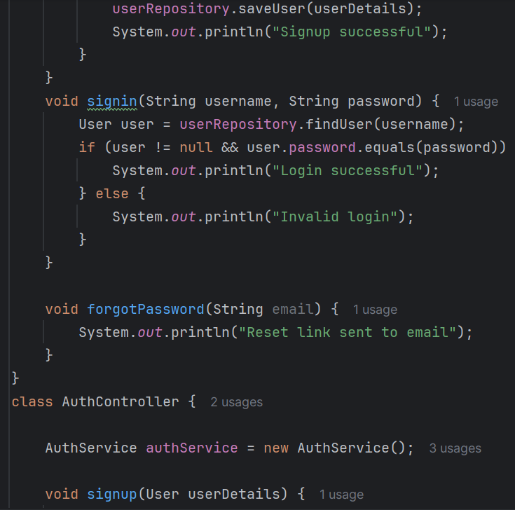
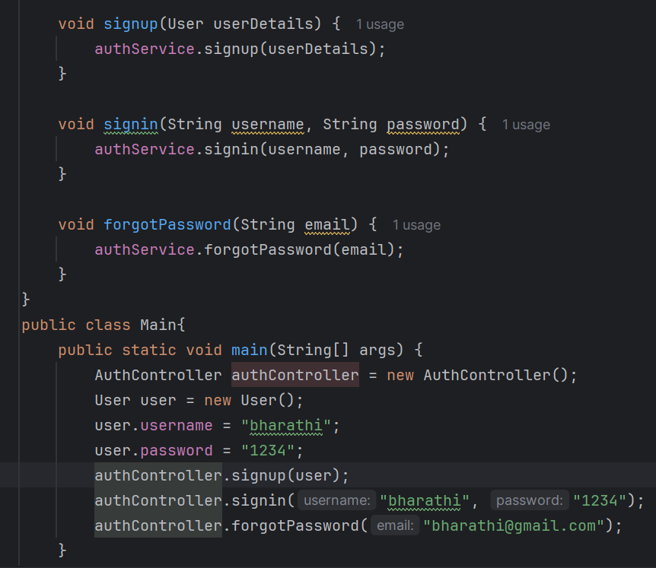
module 1
4

Slide 5
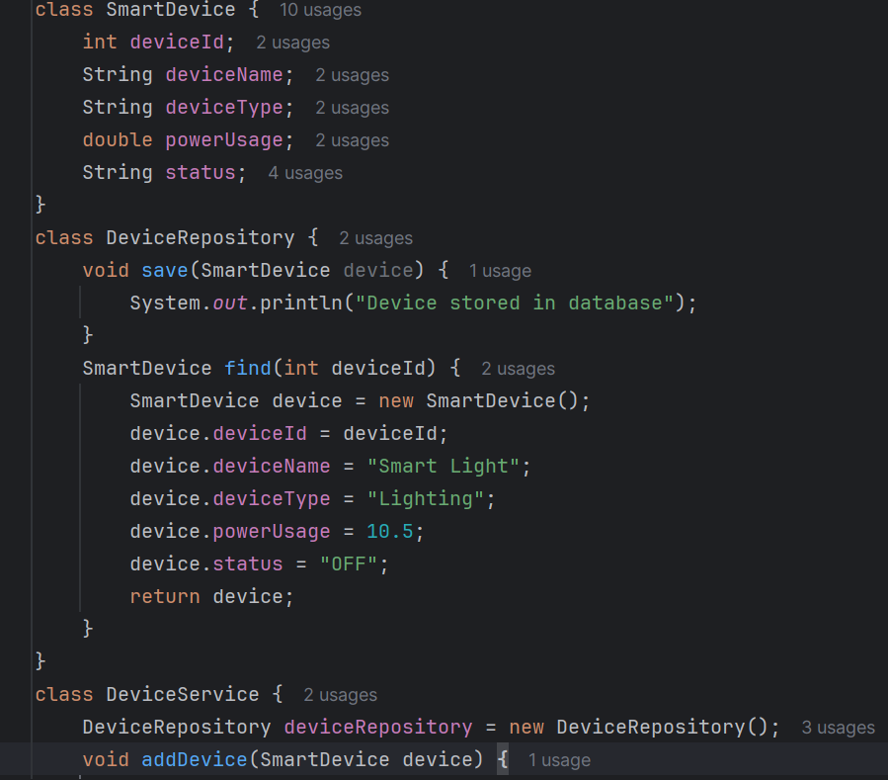
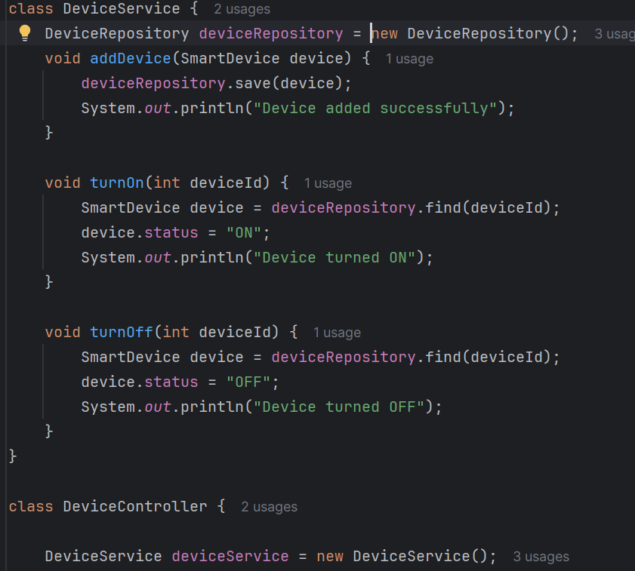
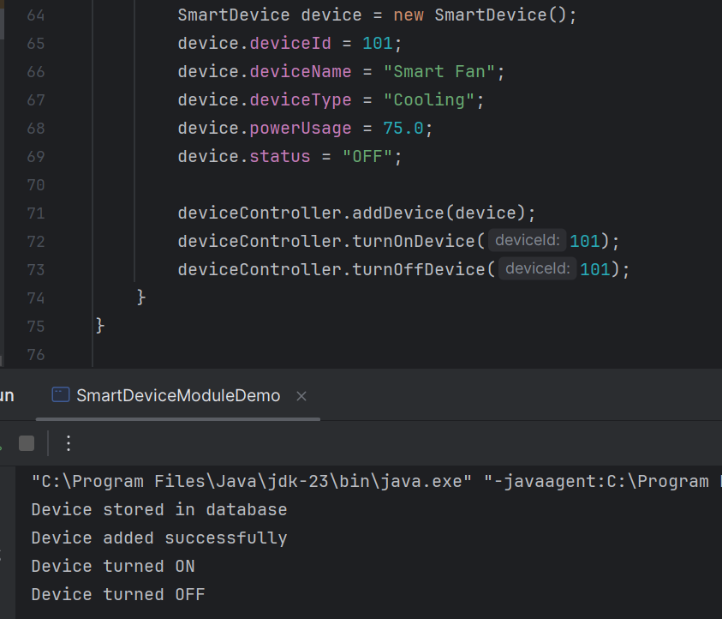
module 2
5

Slide 6
Classes & Their Responsibilities
📊 UsageLog
Represents energy usage data of a device
Stores device ID, timestamp, duration, and power usage
Acts as the data model for energy tracking
🗄️ UsageRepository
Stores energy usage data in the database
Retrieves usage history when required
Maintains consistency of energy records
🎮 EnergyTrackingController
Receives energy tracking requests from the system
Triggers logging when device state changes
Acts as the entry point for energy tracking operations
⚙️ EnergyTrackingService
Calculates energy consumption based on device usage
Applies business logic for usage tracking
Prepares usage data before saving
6

Slide 7
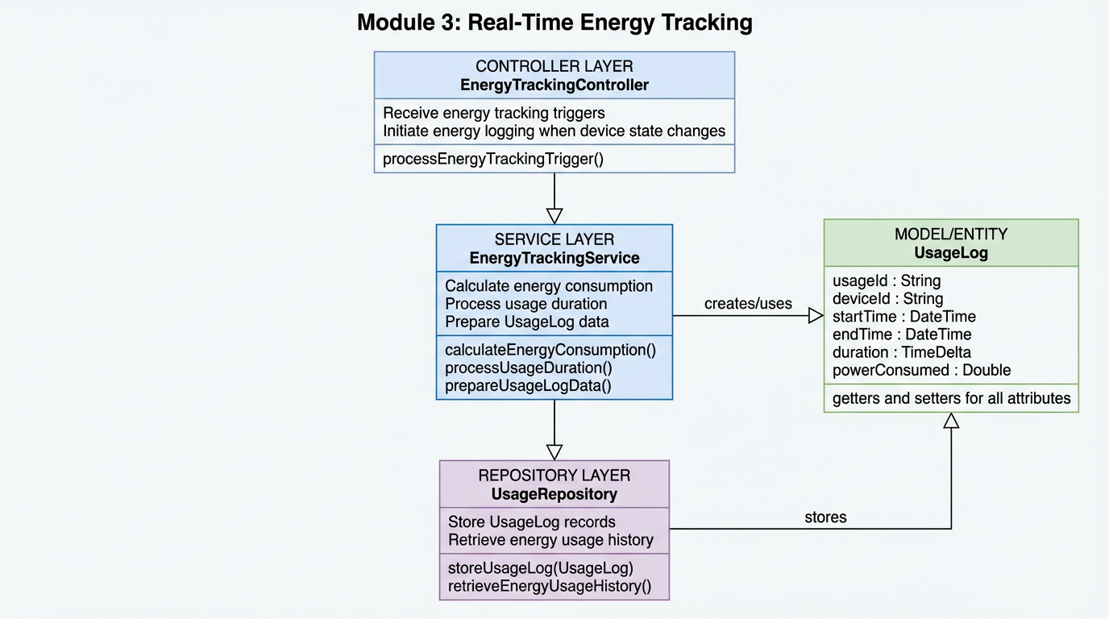
WORK FLOW
Module 3 – Working Flow
Device state changes in Module 2
EnergyTrackingController receives tracking trigger
EnergyTrackingService calculates energy usage
UsageLog object is created
UsageRepository saves data
Data is available for analytics and dashboard
7

Slide 8
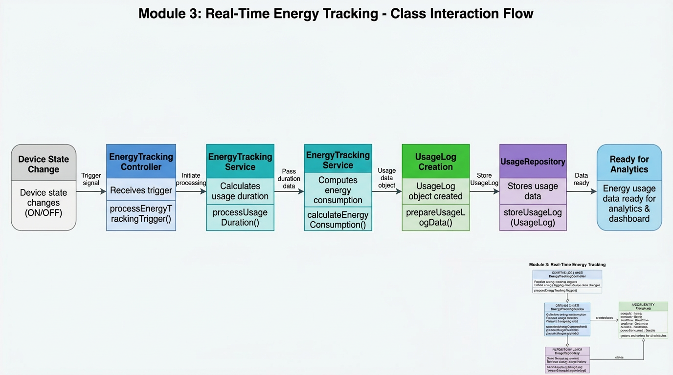
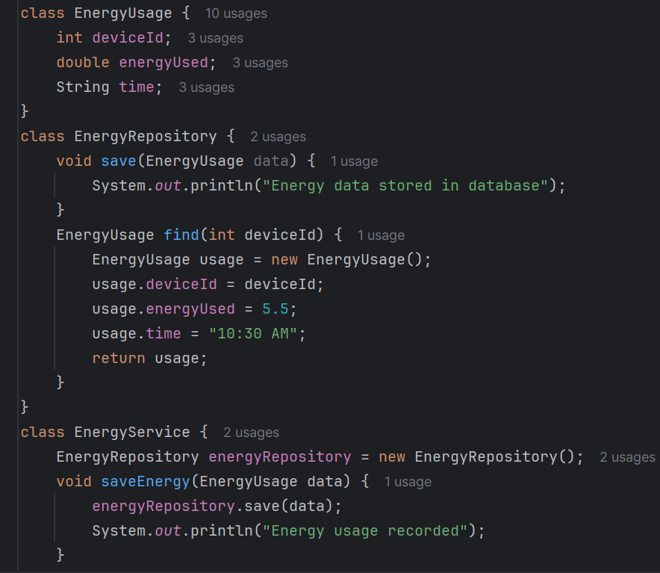
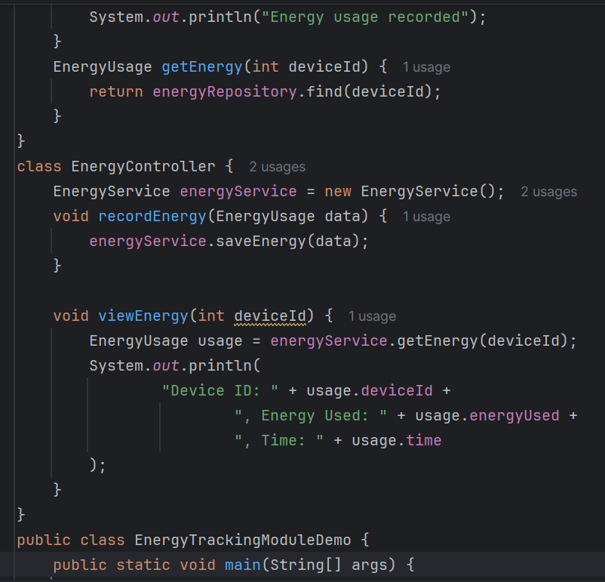
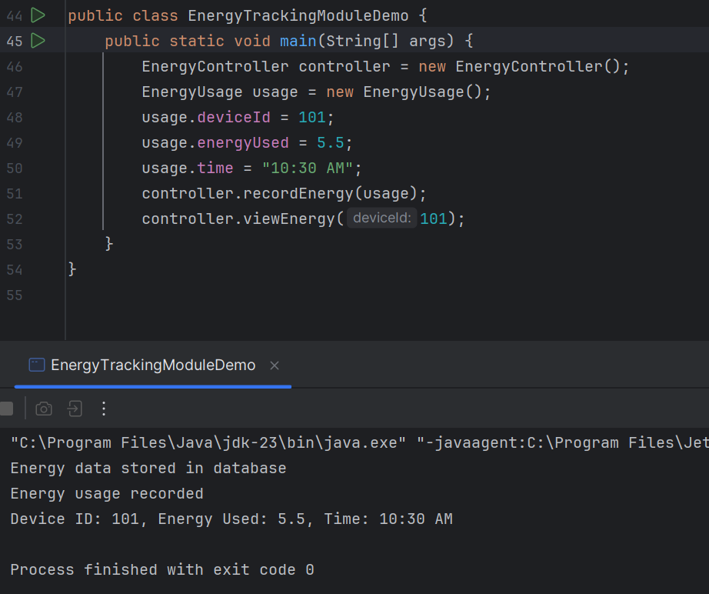
functioning of module 3
8

Slide 9
thankyou
9

